Slide 1

iOS Dev Camp #3 Week 6 UICollectionViewController
Edward Chiang
2014.11.10 - 2014.11.14

Slide 2

Today
UICollectionViewController
UICollectionView
UICollectionViewCell

Slide 3
UICollectionViewController

Slide 4
UICollectionView
The data source object is the content that your app displays. It could be an object from your app’s data model, or it could be the view controller that manages the collection view. The only requirement of the data source is that it must be able to provide information that the collection view needs, such as how many items there are and which views to use when displaying those items.
How many sections does the collection view contain?
For a given section, how many items does a section contain?
For a given section or item, what views should be used to display the corresponding content?

Slide 5
UICollectionView
Sections and items are the fundamental organizing principle for collection view content. A collection view typically has at least one section and may contain more. Each section, in turn, contains zero or more items. Items represent the main content you want to present, whereas sections organize those items into logical groups.

Slide 6
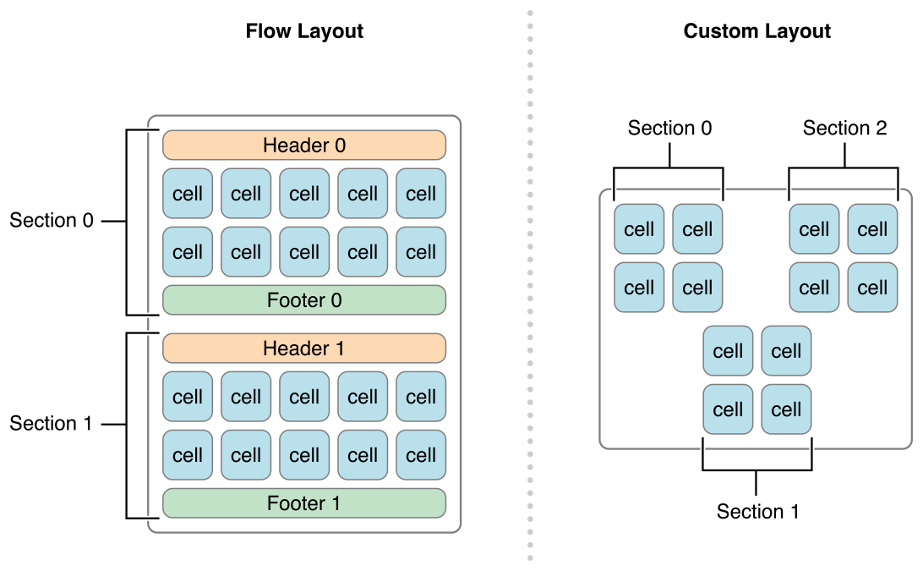
UICollectionView

Slide 7
Designing Your Data Objects
Organizing your data into sections and items makes it much easier to implement your data source methods later. And because your data source methods are called frequently, you want to make sure that your implementations of those methods are able to retrieve data as quickly as possible.
One simple solution (but certainly not the only solution) is for your data source to use a set of nested arrays. In this configuration, a top-level array contains one or more arrays representing the sections of your data source. Each section array then contains the data items for that section. Finding an item in a section is a matter of retrieving its section array and then retrieving an item from that array. This type of arrangement makes it easy to manage moderately sized collections of items and retrieve individual items on demand.

Slide 8
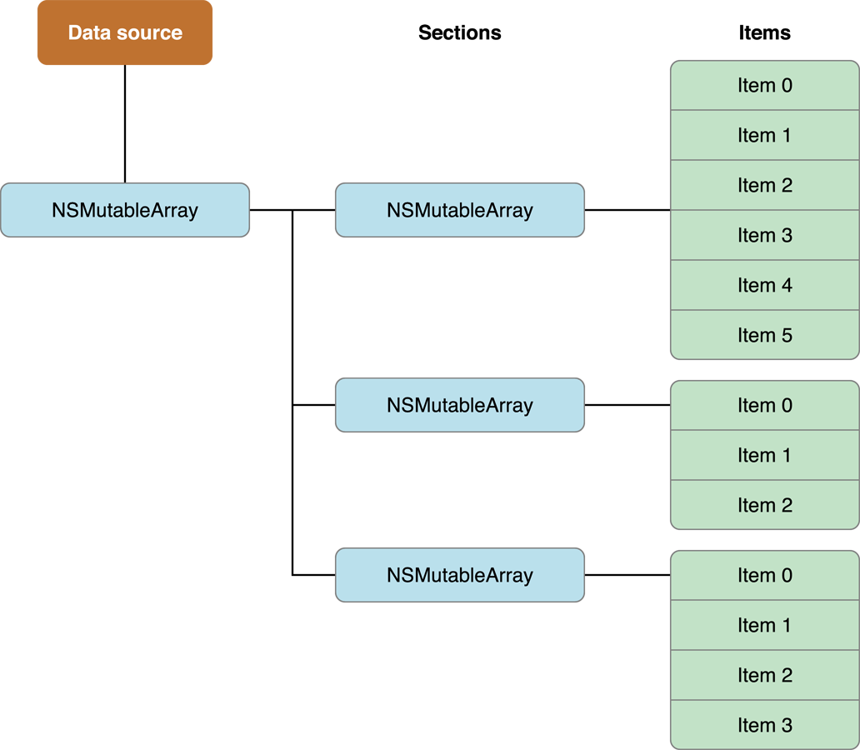
Nested Arrays

Slide 9
Telling Your Content
The collection view is displayed for the first time.
You assign a different data source object to the collection view.
You explicitly call the collection view’s reloadData method.
The collection view delegate executes a block using performBatchUpdates:completion: or any of the move, insert, or delete methods.

Slide 10
Configuring Cells
The collection view uses that list to ask your data source for the corresponding cells and supplementary views. To provide those cells and supplementary views, your code must do the following:
Embed your template cells and views in your storyboard file. (Alternatively, register a class or nib file for each type of supported cell or view.)
In your data source, dequeue and configure the appropriate cell or view when asked.

Slide 11
Registering Your Cells
Configure cells and views in your storyboard. When configuring cells and supplementary views in a storyboard, you do so by dragging the item onto your collection view and configuring it there. This creates a relationship between the collection view and the corresponding cell or view.
For cells, drag a Collection View Cell from the object library and drop it on to your collection view. Set the custom class and the collection reusable view identifier of your cell to appropriate values.
For supplementary views, drag a Collection Reusable View from the object library and drop it on to your collection view. Set the custom class and the collection reusable view identifier of your view to appropriate values.

Slide 12
Dequeueing and Configuring Cells
Implementation of these methods follows a very simple pattern:
Dequeue a cell or view of the appropriate type using the dequeueReusableCellWithReuseIdentifier:forIndexPath: or dequeueReusableSupplementaryViewOfKind:withReuseIdentifier:forIndexPath: method.
Configure the view using the data at the specified index path.
Return the view.

Slide 13
Showing the Edit Menu for a cell
When the user performs a long-tap gesture on a cell, the collection view attempts to display an Edit menu for that cell. The Edit menu can be used to cut, copy, and paste cells in the collection view. Several conditions must be met before the Edit menu can be displayed.

Slide 14
~ END ~
http://www.alphacamp.tw

